Slide 1

Project LexiCon
Building a Brain Computer Interface
Rohak Singhal
BEng (CE) Year 4

Slide 2
Outline
Introduction
Apparatus
Methodology
Architecture
Results and Performance Measure
Conclusion

Slide 3
RECAP

Slide 4
Introduction

Slide 5
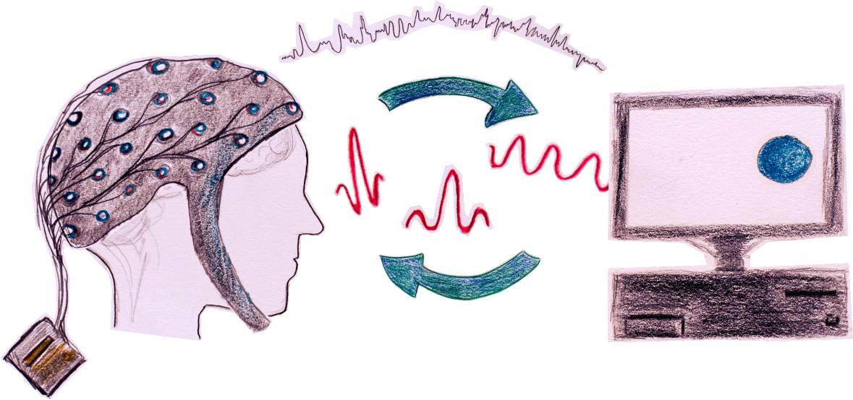
What is a Brain Computer Interface (BCI)
Brain produces electrical activity in performing its functions.
Electrical activity can be recorded using electrodes on the scalp.
BCI recognises patterns from data extracted from the brain.
Patterns then associated with commands.

Slide 6
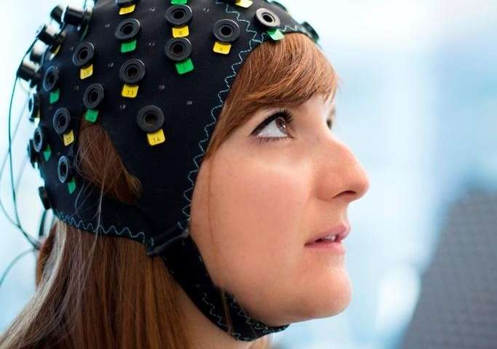
UP!

Slide 7
Project Aims and Significance
Establish a well documented process to develop a BCI system from scratch.
To help university students to continue research in this field.
Build a simple real time BCI application.
To demonstrate the capabilities of the BCI system.
Analyse if the low resource BCI hardware can be used to extract meaningful mental information.
To reduce cost of development.

Slide 8
Revised Objectives
Focus on building a better model for real-time command classification
Application not the focus
Machine Learning
Use thoughts or “motor imagery” instead of physical movement
Demonstrate the application in real-time

Slide 9
Apparatus

Slide 10
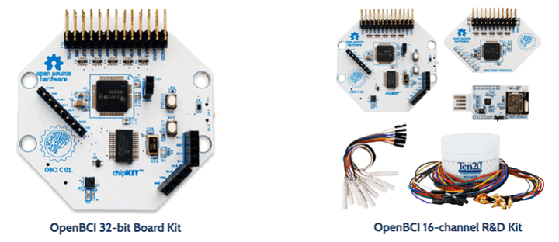
Hardware: OpenBCI Cyton and Daisy
Total of 16 channels from the combined boards
Greater accuracy and brain coverage
Compatible with most BCI software libraries

Slide 11
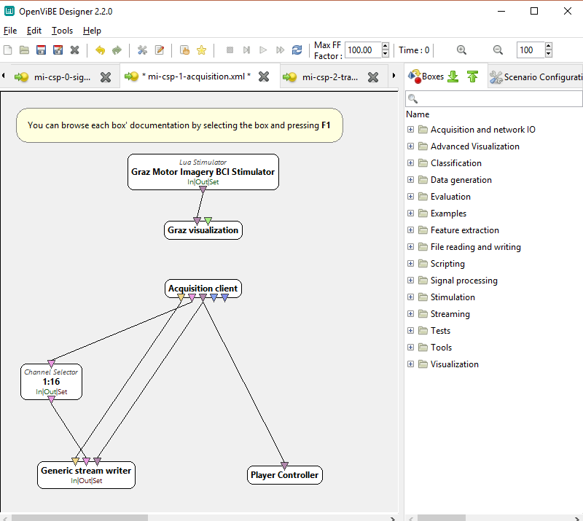
Software: OpenVibe Designer
Modules can be configured, edited, chained and used
Best for rapid prototyping

Slide 12
Methodology

Slide 13
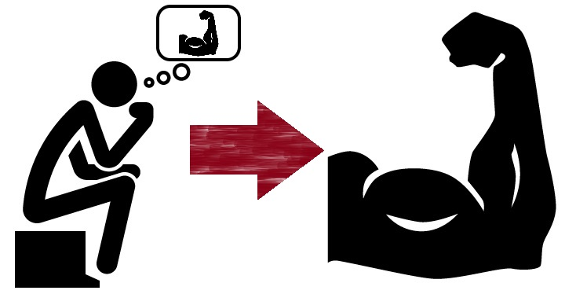
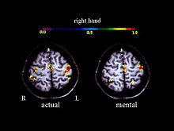
Mapping Principle: Motor Imagery
Performing an action and thinking of the same action
Activate same areas in the brain
Thus thinking of left or right hand should give results similar to moving them
First classify arm movement
Attempt motor imagery

Slide 14
Process Flow
Signal Acquisition
Signal Processing
Feature Engineering and Extraction
Command Classification
Virtual Gaming Application

Slide 15
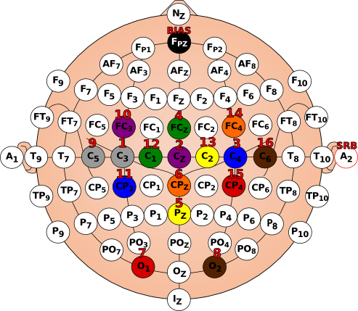
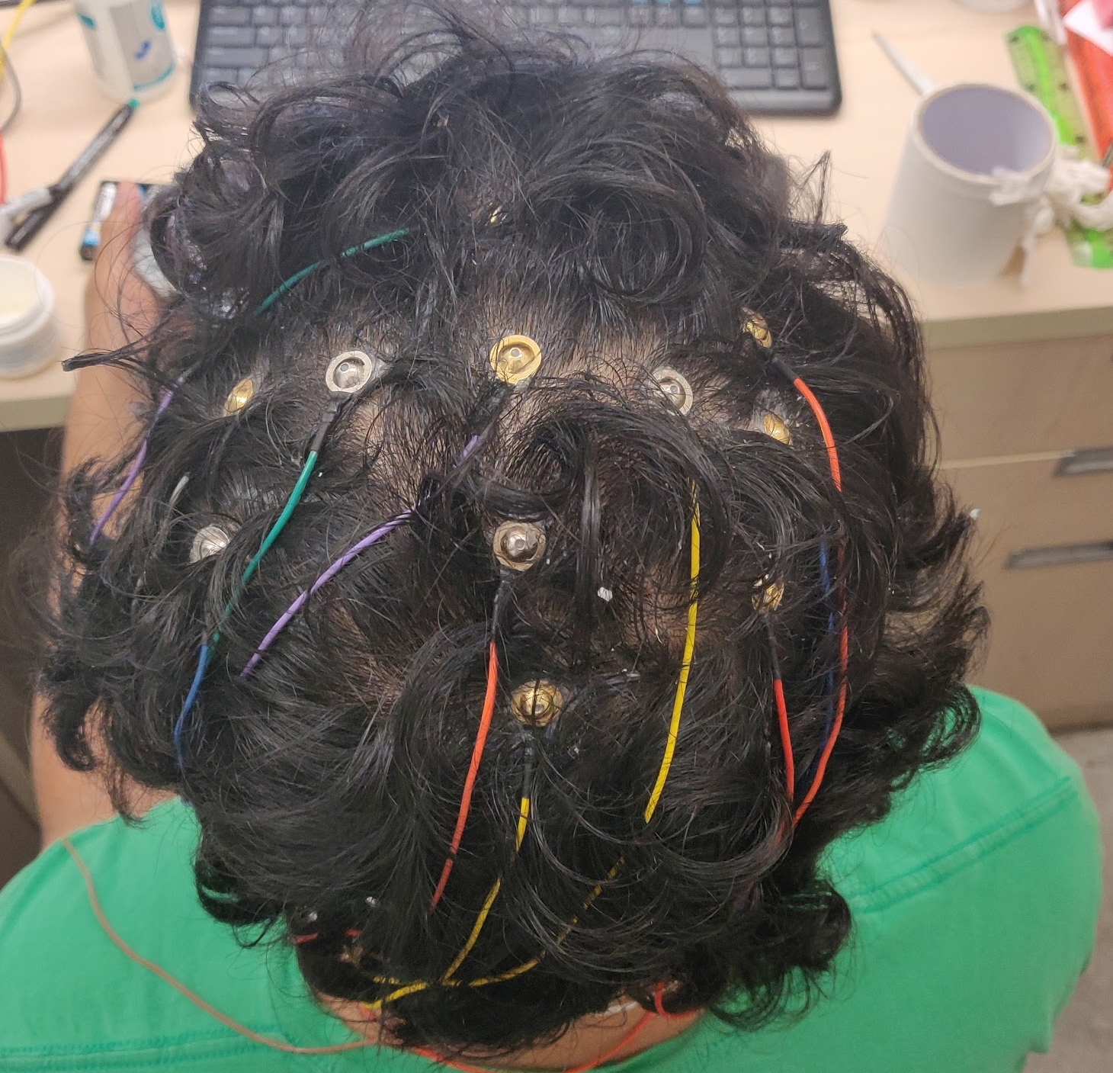
Signal Acquisition: Electrode Placement
Used international 10-20 standard of placement
Used brain areas known for movement and discrimination between left and right body areas

Slide 16

Data Acquisition: Stimulation
Stare at blank screen for 30s
Allow brainwaves to settle
Green Cross indicates user to get ready
Arrow direction indicates
Which side to move/think (left vs right)
3 Separate Tasks
Moving Arms
Moving Fingers
Motor Imagery
20 trials for each side (left and right)

Slide 17
Architecture and Implementation

Slide 18



Data Acquisition: Process
OpenBCI Cyton + Daisy
OpenVibe Acquisition Server
OpenVibe Acquisition Client
Write EEG File
Visualization Stimulus
Stimulation shown to user
Data recorded to file as user responds

Slide 19


Signal Processing and Feature Engineering
Right Trials
Read EEG File
Temporal Filter
8-38 Hz
Train CSP Filter
Left Trials
Temporal Filter extracts frequencies in the alpha and beta region (8-30Hz)
CSP Filter produces features by linear combination of EEG data
Maximize class variance for 1st class
Minimize for 2nd class

Slide 20
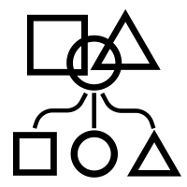
Classification
Read EEG File
Power Spectral Density
Real-time Data
Temporal Filter
8-38 Hz
CSP Filter
ML Classifier
Accuracy
Testing Visualization
Power Spectral Density estimates the total magnitude (power) of the signal
Calculates the power associated with the signals captured from the different regions of the brain while performing an action

Slide 21
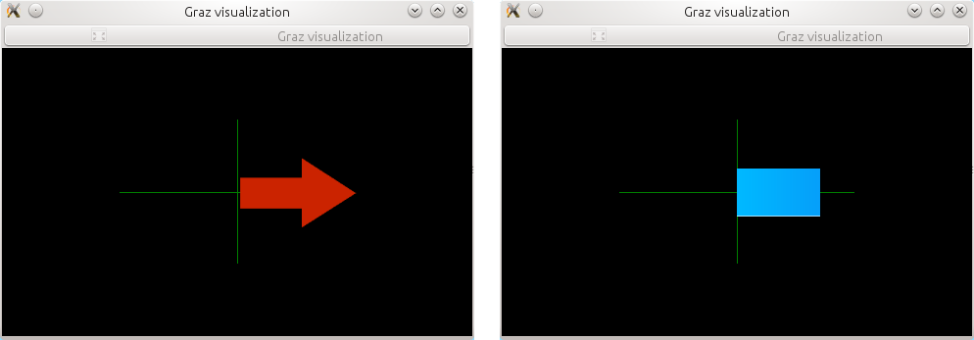
Testing Visualization
Red Arrow
Direction to move/think of moving
Blue Bar
Which side is detected (left/right)
Length denotes confidence

Slide 22
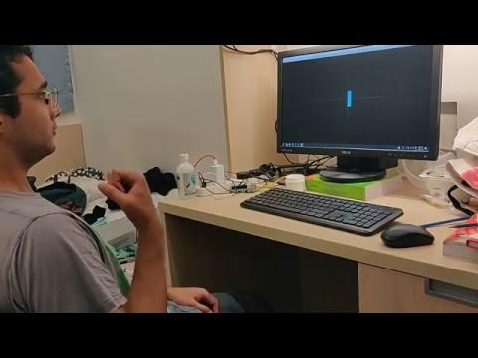
Testing Demo

Slide 23
Model Improvements and Variations
Perceptron,SVM,
LDA
Temporal Filter
4-8 Hz
6 Filter Architecture
2 Filter Architecture
Temporal Filter
8-12 Hz
Temporal Filter
12-16Hz
Read Data
Temporal Filter
12-38 Hz
Power Spectral Density
Temporal Filter
8-30 Hz
CSP Filter
ML Classifier
Temporal Filter
16-20Hz
Accuracy
Visualization
Temporal Filter
20-25 Hz
Temporal Filter
25-38Hz

Slide 24
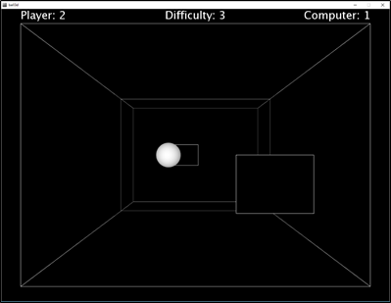
Application Development
3D Game written in Processing framework
Arcade version of pong
Paddle controlled by command from model
Goal is to hit the ball back towards the opponent
3d Pong in Processing

Slide 25
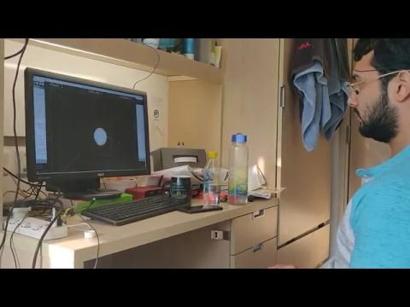
Game Control Demo

Slide 26
Results and Analysis

Slide 27
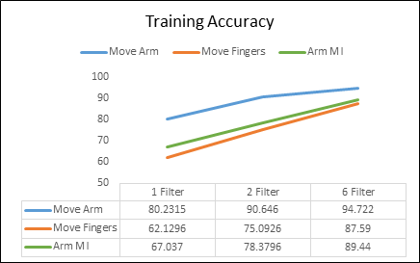
Performance Measure
Measure classification rate
Comparing architectures and responses (movements)
Significant improvement in 6-filter approach
Arm MI improved significantly from 67% to 89%

Slide 28
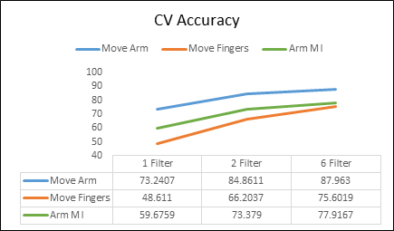
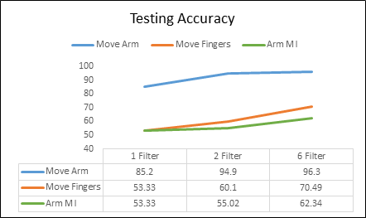
Testing Accuracies
Testing Accuracy for Arm Motor Imagery (MI) is 62% with 6 Filters
Possible that user cannot generate strong enough motor imagery
Fair degree of control observed in gameplay
Accuracy of Moving Arm > Arm MI > Moving Fingers

Slide 29
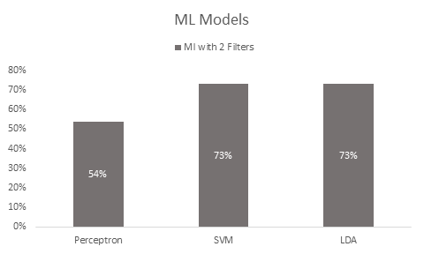
Model Comparison
LDA and SVM give similar performance.
Fig shows 2 filters
Best with 6 filters
Perceptron performs very poorly compared to the others

Slide 30
Conclusion and Future Direction

Slide 31
Significance and Contributions
Built an end-to-end real time BCI system
Demonstrated its power using a 3D video game
System is well documented, easy to modify and can be reproduced from instructions
Promote research interest in student and maker community
Improved classification accuracy of current BCI models
Established a baseline for future research

Slide 32
Challenges and Limitations
Accuracy affected by both model and human error
More training fatigues user thus ineffective
Several unknown variables
Noise affected by nearby electromagnetic fields, sweat etc
Lack of comprehensive information, documentation and support.

Slide 33
Conclusion: Key Points
LexiCon can recognize user’s thoughts and classify them in real time.
Commands provide enough control to play simple video games.
Significant accuracy improvements were made
Can try to improve further by varying architecture or training the user

Slide 34
Future Applications
Multiplayer video games
Rehabilitation therapy
People with lost limbs can train their body for prosthetic attachment
Controlling wheelchair

Slide 35
THANK YOU!
Any Questions?

Slide 36
References
[1] J. J. Shih, D. J. Krusienski and J. R. Wolpaw, "Brain-Computer Interfaces in Medicine," Mayo Foundation, March 2012.
[2] J. R. Wolpaw, N. Birbaumer, D. J. McFarland, G. Pfurtscheller, and T. M. Vaughan, “Brain–computer interfaces for communication and control,” http://www.cs.cmu.edu/~tanja/BCI/BCIreview.pdf. [Online]. Available: http://www.cs.cmu.edu/~tanja/BCI/BCIreview.pdf
[3] "Ganglion Board (4-channels)," [Online]. Available: https://shop.openbci.com/products/pre-order-ganglion-board?variant=13461804483. [Accessed 30 October 2018].
[4] OpenBCI, “OpenBCI/OpenBCI_GUI,” GitHub, 19-Aug-2018. [Online]. Available: https://github.com/OpenBCI/OpenBCI_GUI. [Accessed: 30-Oct-2018].

Slide 38
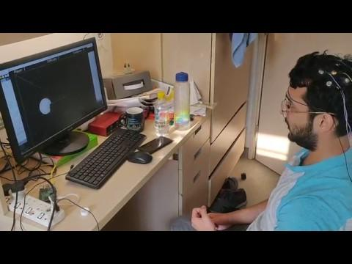
Demo

Slide 39
